Slide 1
K. E. Society’s
Rajarambapu Institute of Technology, Rajaramnagar
A Presentation On
Mall Customer Segmentation Using K-Means Clustering Algorithm
Under the Course Neural Network and Deep Learning (IT4032)
Sr. No. | Student Name | Enroll. No.
1.
2.
3.
4.
Under Guidance of
Dr. A. C. Adamuthe

Slide 2
CONTENTS
Introduction
Problem Statement
Motivation
Methodology
Objective
Requirements
About Algorithm
Flowchart
About Dataset
Elbow Method
Result
Conclusion
Reference

Slide 3
INTRODUCTION
Management of customer relationship has always played a vital role to provide business intelligence to organizations to build, manage and develop valuable long term customer relationships.
The importance of treating customers as an organizations main asset is increasing in value in present day and era. Organizations are investing rapidly in the development of customer acquisition, maintenance and development strategies. The business intelligence has a vital role to play in allowing companies to use technical expertise to gain better customer knowledge and Programs for outreach. By using clustering techniques, customers with similar means are clustered together. Customer segmentation helps the marketing team to recognize and expose different customer segments that think differently and follow different purchasing strategies.
Customer segmentation helps in figuring out the customers who vary in terms of preferences, expectations, desires and attributes. The main purpose of performing customer segmentation is to group consumers with similar interest so that the marketing team can converge in an effective marketing plan.

Slide 4
PROBLEM STATEMENT
Malls or shopping complexes are often indulged in the race to increase their customers and hence making huge profits. To achieve this task machine learning is being applied by many stores already.
It is amazing to realize the fact that how machine learning can aid in such ambitions. The shopping complexes make use of their customers’ data and develop ML models to target the right ones. This not only increases sales but also makes the complexes efficient.

Slide 5
MOTIVATION
Let's imagine you're owning a supermarket mall and through membership cards, you have some basic data about your customers like Customer ID, age, gender, annual income and spending score, which is something you assign to the customer based on your defined parameters like customer behavior and purchasing data.
The main aim of this problem is learning the purpose of the customer segmentation concepts, also known as market basket analysis, trying to understand customers and separate them in different groups according to their preferences, and once the division is done, this information can be given to marketing team so they can plan the strategy accordingly.

Slide 6
METHODOLOGY
Machine Learning
Unsupervised Learning
Clustering
K-Means Clustering Algorithm
Elbow Method

Slide 7
OBJECTIVES
The main Objectives of Customer Segmentation are :-
To reduce the distance between the data points and their respective cluster centroid.
To minimize the sum of distances between the points and their respective cluster centroid.
Customers to get a better understanding of them which in turn could be used to increase the revenue of the company.

Slide 8
REQUIREMENTS
Google Colab
Kaggle
Javatpoint
Libraries used in this Project :-
Numpy
Pandas
Matplotlib
Seaborn
Scikit-learn

Slide 9
K-MEANS CLUSTERING ALGORITHM
K-Means Clustering is an Unsupervised Learning Algorithm , which groups the unlabeled dataset into different clusters. Here K defines the number of pre-defined clusters that need to be created in the process, as if K=2, there will be two clusters, and for K=3, there will be three clusters, and so on.
It is an iterative algorithm that divides the unlabeled dataset into k different clusters in such a way that each dataset belongs only one group that has similar properties.
It is a centroid-based algorithm, where each cluster is associated with a centroid. The main aim of this algorithm is to minimize the sum of distances between the data point and their corresponding clusters.
The algorithm takes the unlabeled dataset as input, divides the dataset into k-number of clusters, and repeats the process until it does not find the best clusters. The value of k should be predetermined in this algorithm.

Slide 10
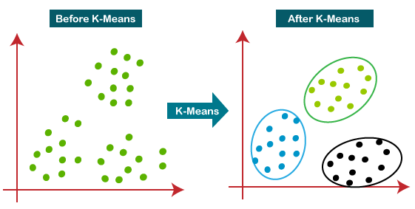
The k-means clustering algorithm mainly performs two tasks:
Determines the best value for K center points or centroids by an iterative process.
Assigns each data point to its closest k-center. Those data points which are near to the particular k-center, create a cluster.
Unsupervised Learning - Clustering

Slide 11
WORKING OF K-MEANS ALGORITHM
Step-1: Select the number K to decide the number of clusters.
Step-2: Select random K points or centroids. (It can be other from the input dataset).
Step-3: Assign each data point to their closest centroid, which will form the predefined K clusters.
Step-4: Calculate the variance and place a new centroid of each cluster.
Step-5: Repeat the third steps, which means reassign each datapoint to the new closest centroid of each cluster.
Step-6: If any reassignment occurs, then go to step-4 else go to FINISH.
Step-7: The model is ready.

Slide 12
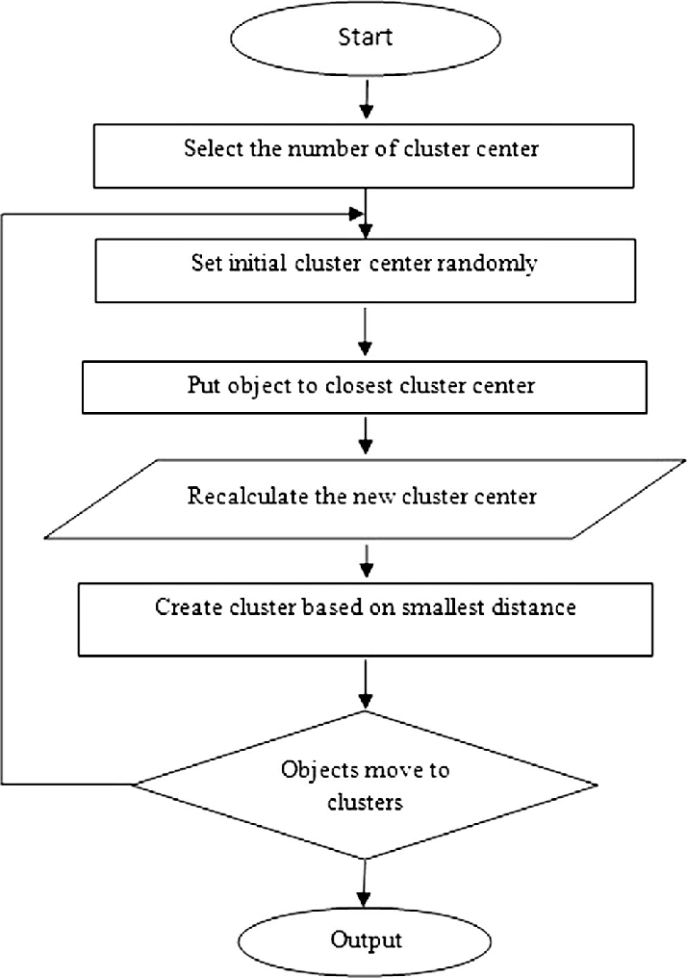
FLOWCHART

Slide 13
MALL CUSTOMER SEGMENTATION
Malls do customer profiling to target the potential customers with irresistible offers whenever they visit the mall.
Customer segmentation enables a company to customize its relationships with the customers, as we do in our daily lives. When you perform customer segmentation, you find similar characteristics in each customer's behavior and needs. Then, those are generalized into groups to satisfy demands with various strategies.

Slide 14
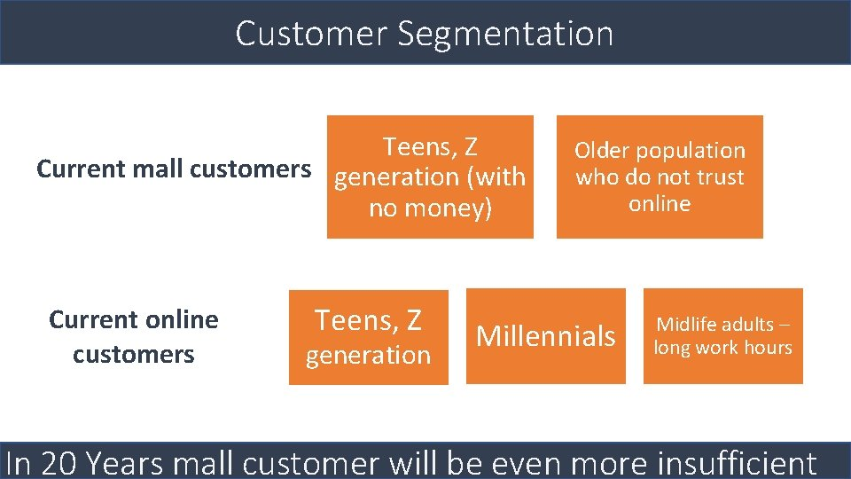

Slide 15
STEPS OF IMPLEMENTATION
Data Pre-processing step.
Finding the optimal number of clusters using the Elbow method.
Training the K-Means Algorithm on the training dataset.
Visualizing the clusters.
Google Colab Link :-
https://colab.research.google.com/drive/1HNOcdg_nxQiUlDgDebSlXvHO5mfsZY7o?usp=sharing

Slide 16
DATASET
A collection of instances is a Dataset.
The dataset includes following features:-
Customer ID
Customer Gender
Customer Age
Annual Income of the customer (in Thousand Dollars)
Spending score of the customer (based on customer behavior and spending nature)
Mall_Customers.csv

Slide 17
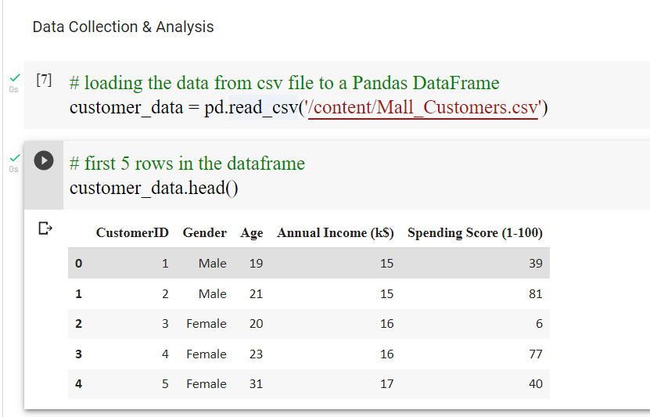
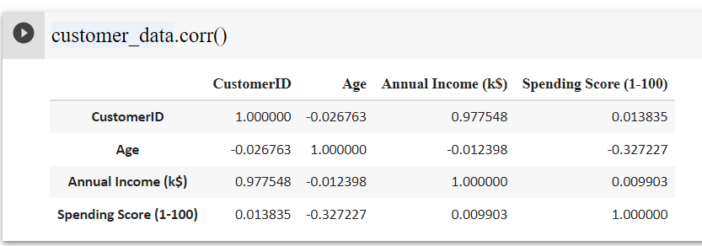
SAMPLE OF DATASET

Slide 18
ELBOW METHOD
The Elbow method is one of the most popular ways to find the optimal number of clusters.
This method uses the concept of WCSS value. WCSS stands for Within Cluster Sum of Squares, which defines the total variations within a cluster.
The formula to calculate the value of WCSS (for 3 clusters) is given below:
WCSS= ∑_{Pi in Cluster1} distance(P_{i} C₁)² +∑_{Pi in Cluster2}distance(P_{i} C₂)²+∑_{Pi in CLuster3} distance(P_{i} C₃)²

Slide 19
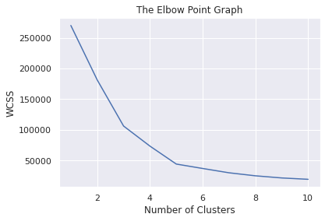
ELBOW GRAPH
Optimum Number of Clusters = 5

Slide 20
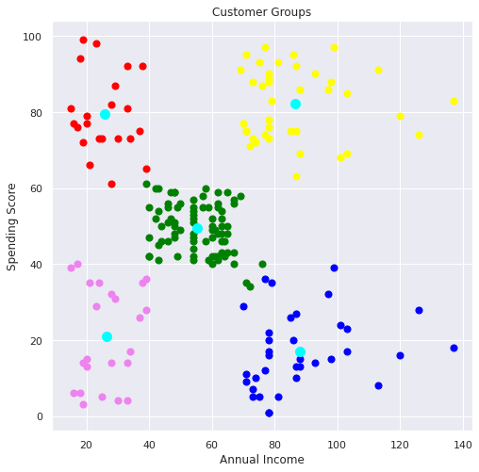
RESULT
After visualizing all 5 clusters of customers

Slide 21
CONCLUSION
From the visualization it can be observed that,
Dataset has five different groups of customers that means five clusters.
All the clusters are partitions in a different way, there is not any mix.
Cluster 1 denotes the customer who has medium annual income and medium spending score.
Cluster 2 represents the customer who has very less annual income but they have very good spending score.
Cluster 3 denotes the customer who has more annual income and they are spending a lot.
Cluster 4 denotes the customer who has very less annual income and also they have very less spending score.
Cluster 5 denotes the customer who has more annual income but they don’t spend much.

Slide 22
REFERENCE
https://www.kaggle.com
https://colab.research.google.com/drive/1HNOcdg_nxQiUlDgDebSlXvHO5mfsZY7o?usp=sharing
https://www.javatpoint.com/k-means-clustering-algorithm-in-machine-learning

Slide 23
Advantages :-
Determine appropriate product pricing.
Develop customized marketing campaigns.
Design an optimal distribution strategy.
Choose specific product features for deployment.
Prioritize new product development efforts.
Disadvantages :-
It requires to specify the number of clusters (k) in advance.
It can not handle noisy data and outliers.
It is not suitable to identify clusters with non-convex shapes.

Slide 24
USES OF CLUSTERING :-
Marketing
Real Estate
Book Store & Library Management
Document Analysis

Slide 25
THANK YOU

